Slide 1
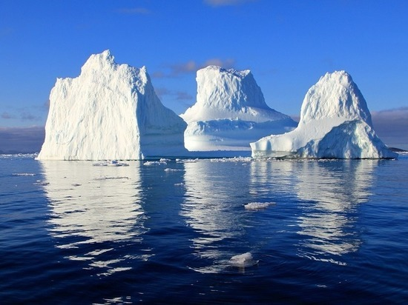
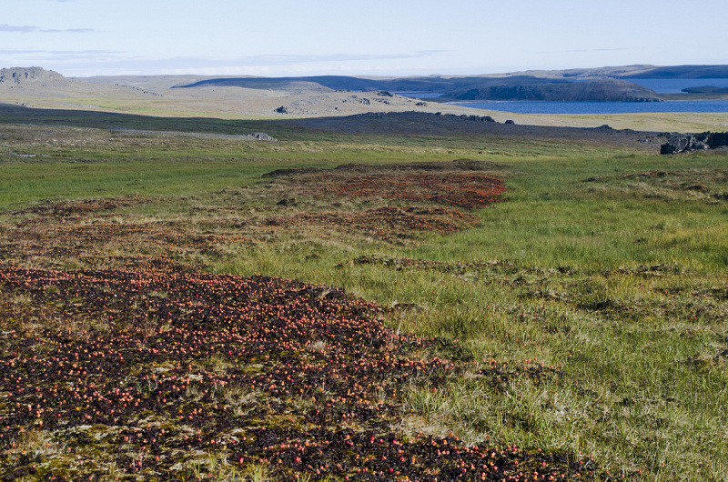
Mikhail Gantsevich, Faculty of Biology, Moscow State University, Russia Sopot, 27 November 2018
Arctic in Russia: trends of scientific research and public perception

Slide 2
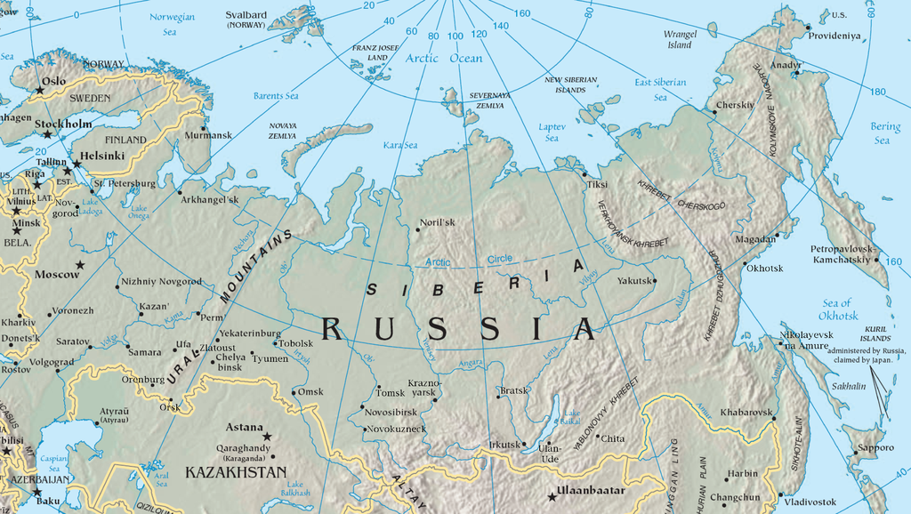

Slide 3
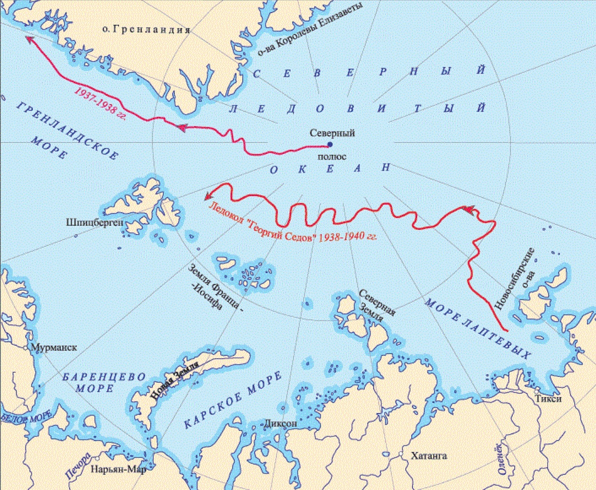
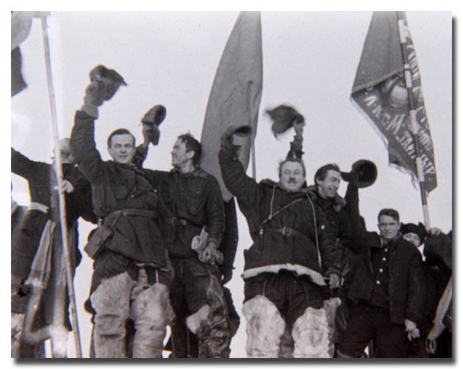
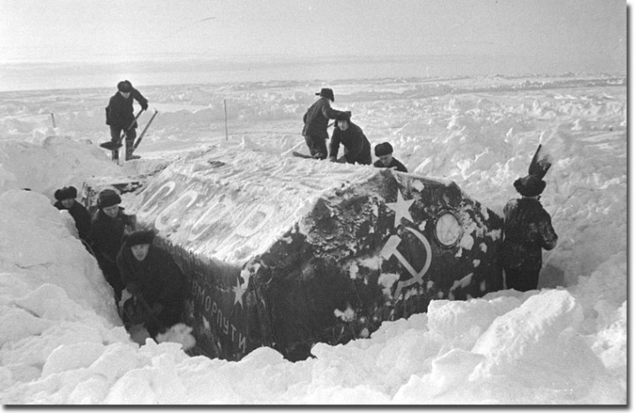

Slide 5
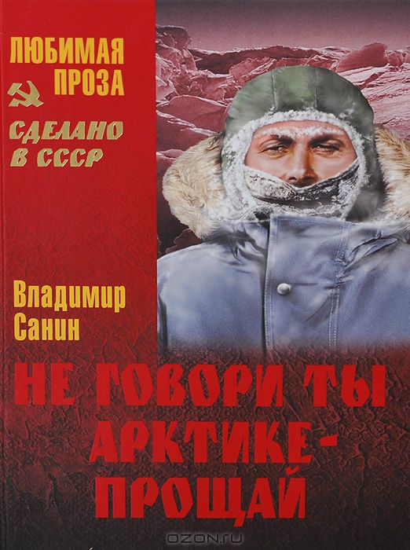

Slide 6
Artic in Russian and international media (from Kovrigina, 2015)

Slide 7
How do you assess the state of the environment in the area of your residence? (Nefteyugansk area, West Siberia)

Slide 8
If bad then why?

Slide 9
The assessment by users of the social media promotion of the “Greenpeace” (2013, under Russian Public Opinion Research Center)

Slide 10
How important for Russia, in your opinion, is to study and develop the natural resources of the Arctic?

Slide 11
Information awareness about polar research in different regions

Slide 12
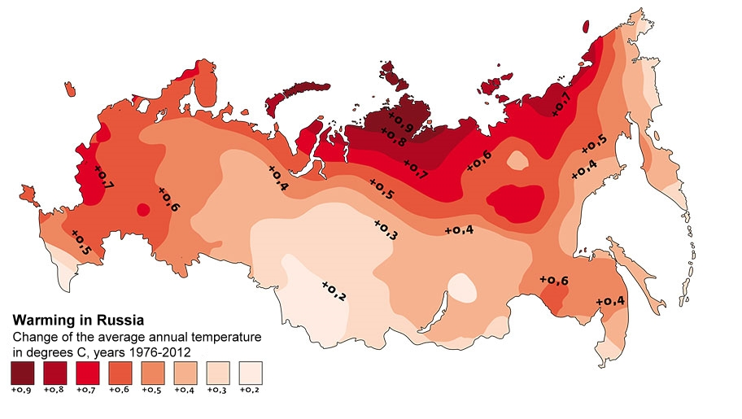

Slide 13
Thank you for attention

