Slide 1
ADAMANT
Arctic benthic ecosystems under change – the impact of deglaciation and boreal species transportation by macroplastic
Kick off meeting 15-17th October 2018, Sopot, Poland

Slide 2

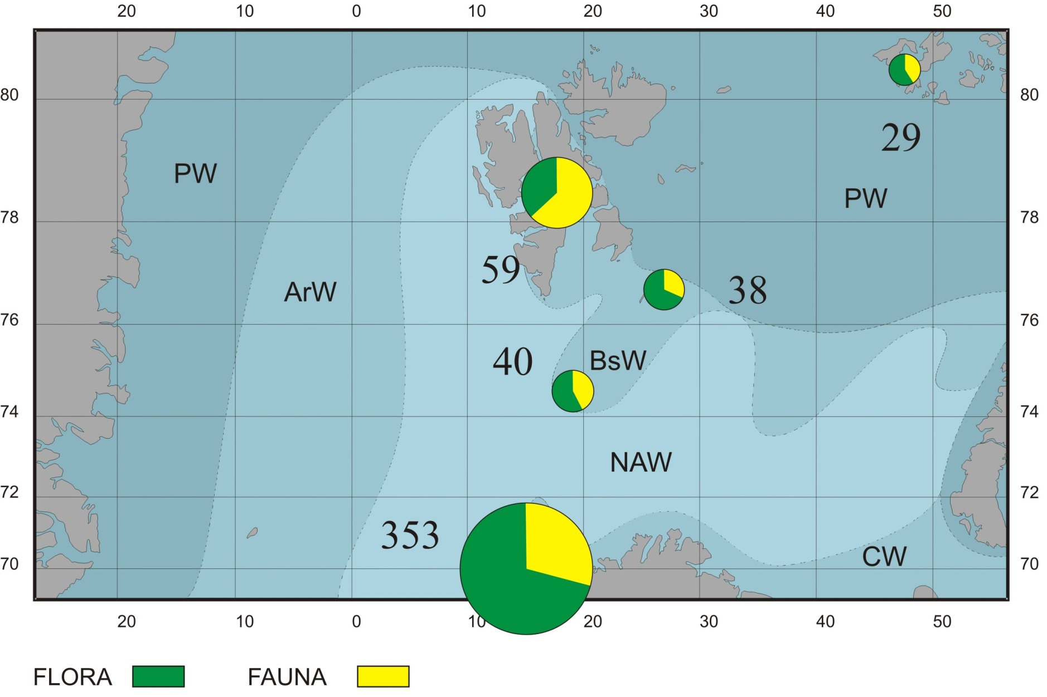
POTENTIAL FOR ADVECTION
NUMBER OF SPECIES INHABITING INTERTIDAL

Slide 3
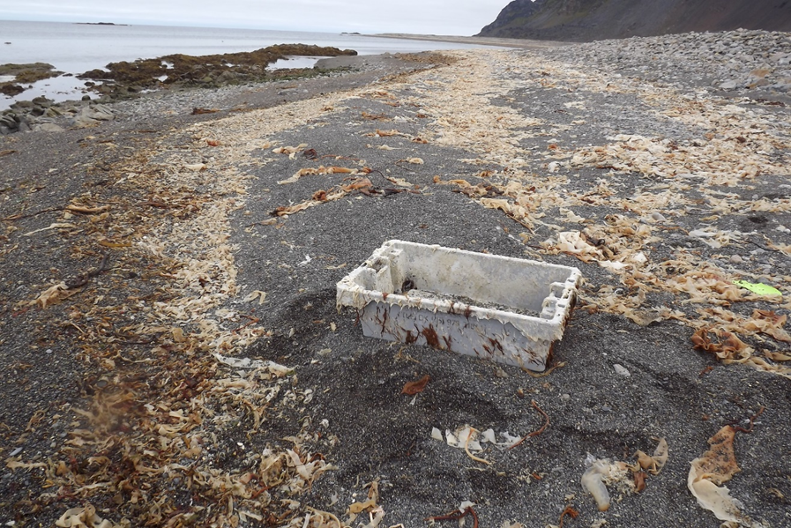
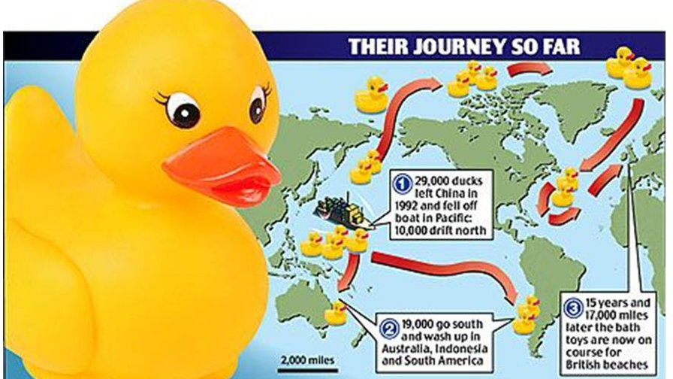
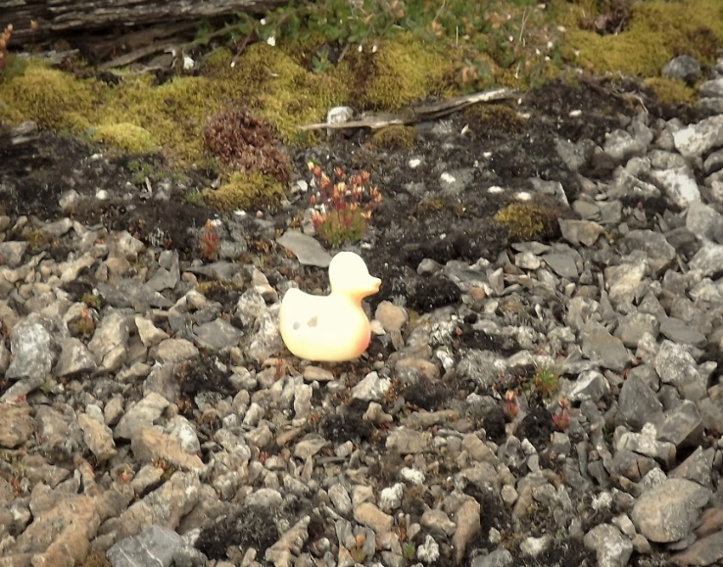
New phenomenon – species rafting on large plastic debris
and the most famous duck in the world, found on Svalbard
7th August 2017, Prins Karl Forlandet, 78oN

Slide 4
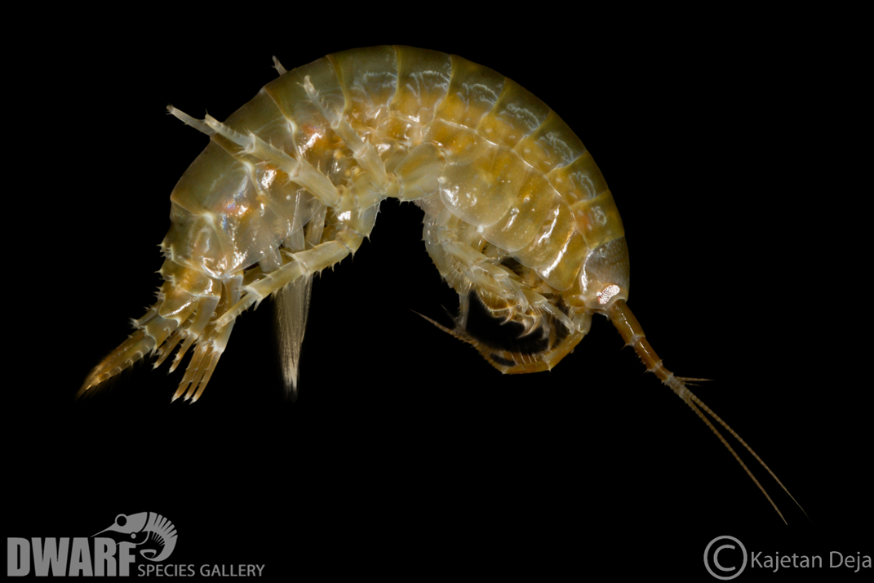
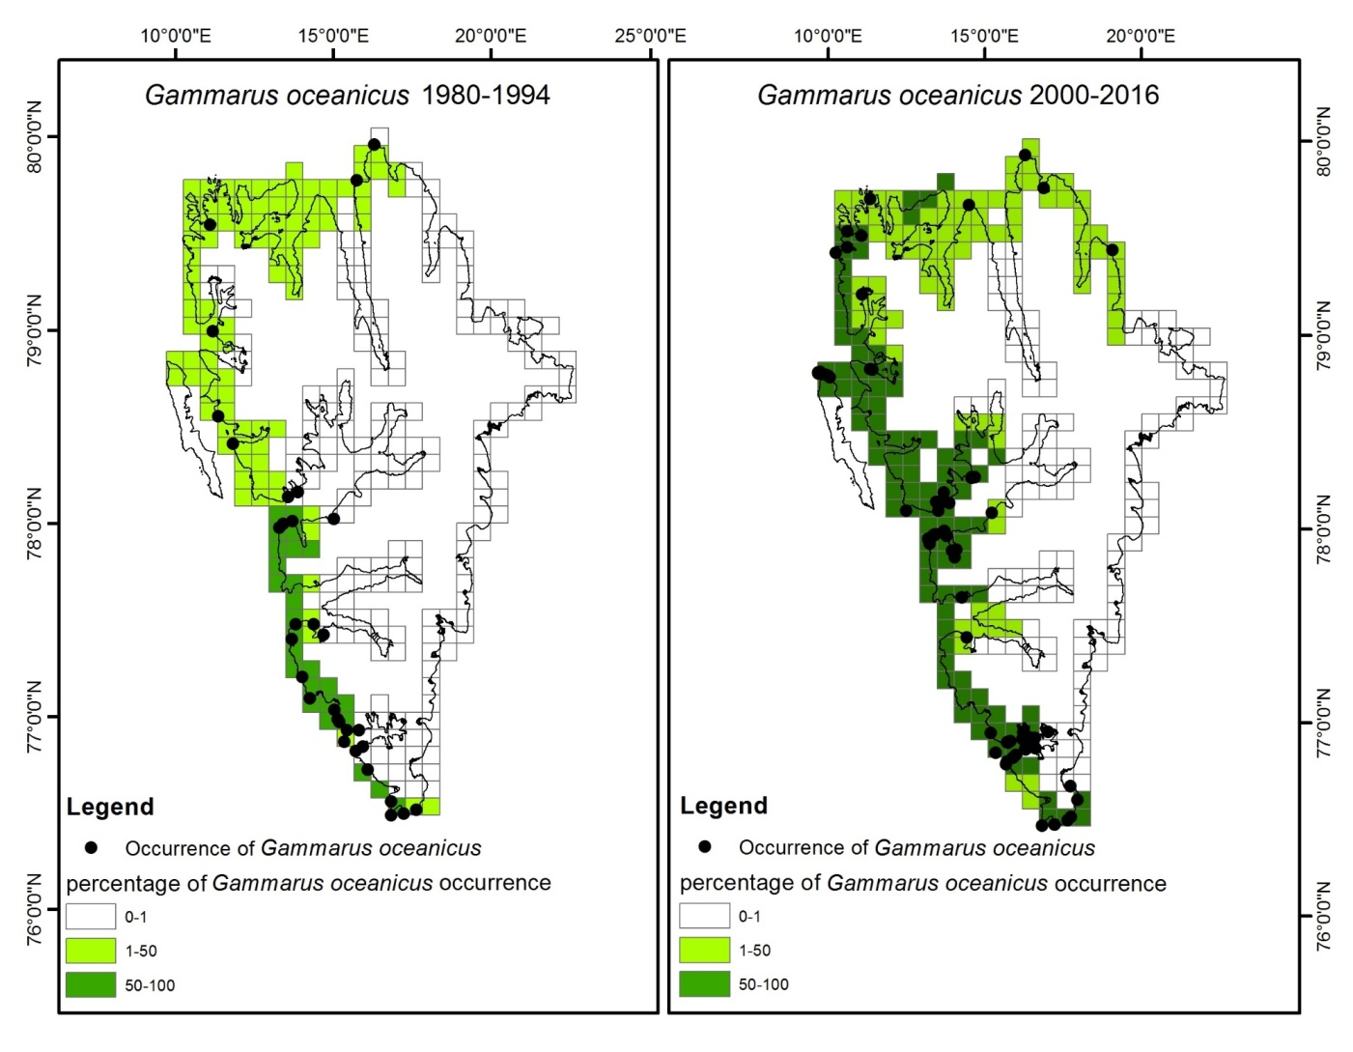
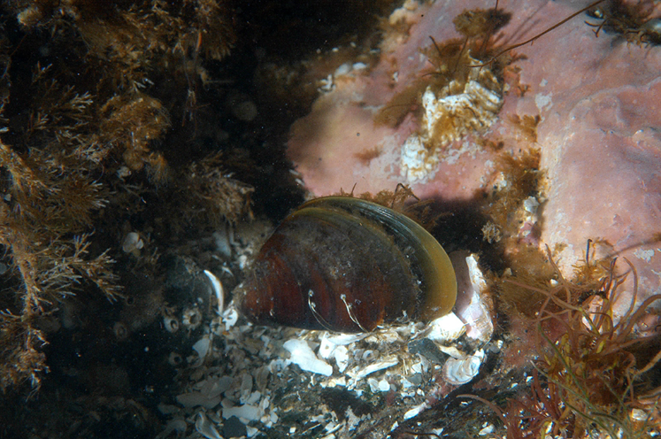
Climate change effects
(de-icing of coast) is much faster
than thermophilic boreal species
advance

Slide 5
Ongoing related projects
ACESS – led by Janne Soreide UNIS with IOPAN – JMW participation (Belmont Fund.)
Aliens on the Beach – Martine van Heuvel Greve – (Sysselmannen Miljovernfond)
Svalbard Intertidal Project – (IOPAN SMF)
Planned CAB H2020- Jorgen Berge UiT

Slide 6
Work packages
WP1- Management
Deliverables :
- synthesis paper
- open data base
- project web page
Leader JMW, Joanna Piwowarczyk, post doc (UG), technic

Slide 7
WP 2- intertidal biocenose de-icing
Deliverables:
- paper on functional ecosystem changes
- georeferenced data for the data base
Leader Joanna Legeżyńska, Kajetan Deja, phD student at UŁ

Slide 8
WP 3 – Rafting the organisms
Deliverables:
- paper on the species rafted to Svalbard
- georeferenced data to the data base
Leader Lech Kotwicki, Mikołaj Mazurkiewicz, phD student

Slide 9
WP 4 – Sublittoral benthic habitats
Deliverables
- paper on soft bottom benthos in impacted and non impacted by glaciers areas
- data to the common data base
Lider : Andrius Siaulis

Slide 10
WP -5 Assessing the expansion of boreal species
Deliverables –
Paper on the coastal benthos changes
Data for the comon data base
Lider: Sergej Olenin

Slide 11
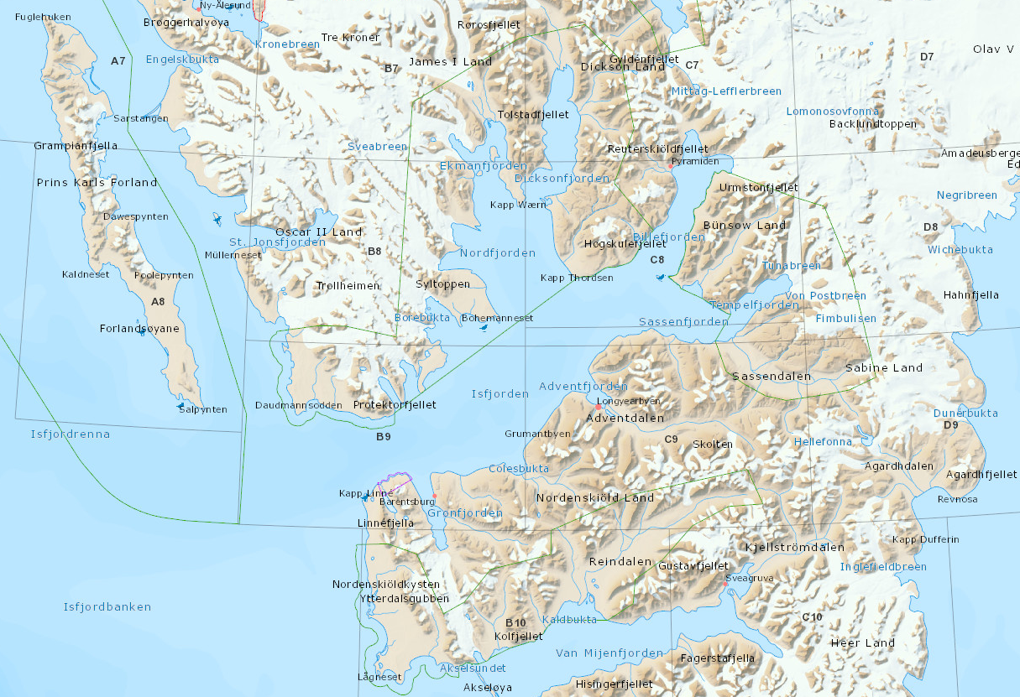
Littoral field work
on Svalbard planned
for 2019 summer
Red-
Ice free coast and
plastic rafts
occurrence

Slide 12
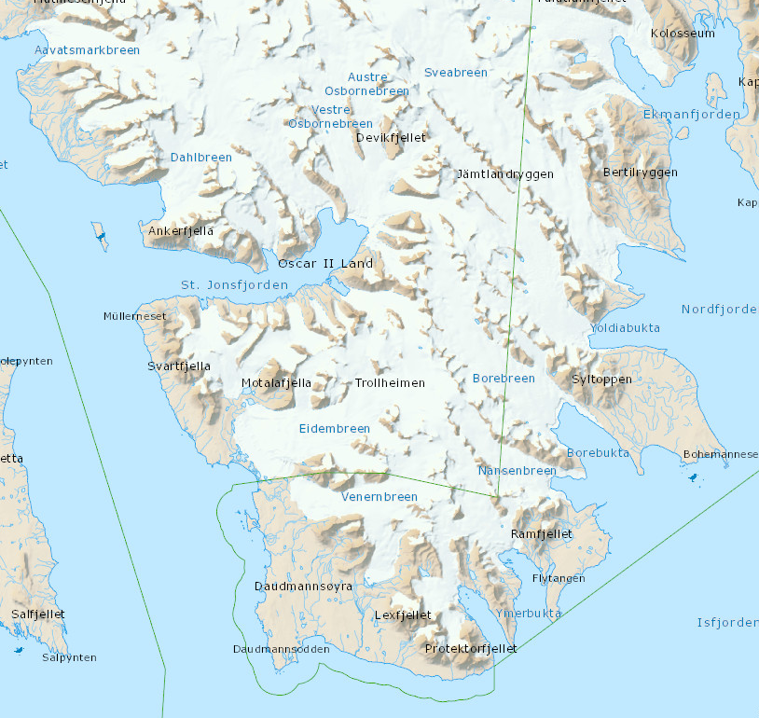
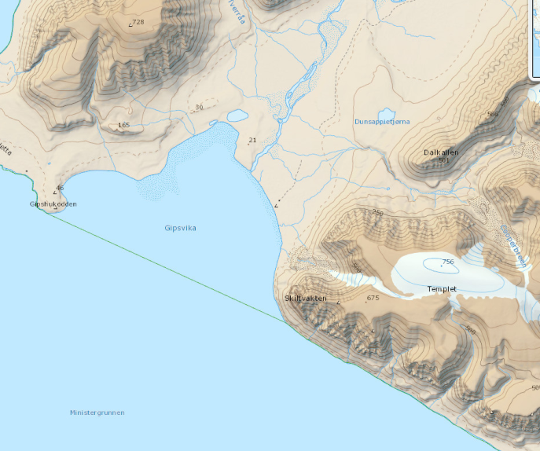
Sublittoral field work
on Svalbard planned 2019 summer
Glacial bays with icebergs
Isfjorden - Yoldiabukta
River mouth with no ice
Isfjorden - Gipsvika

Slide 13
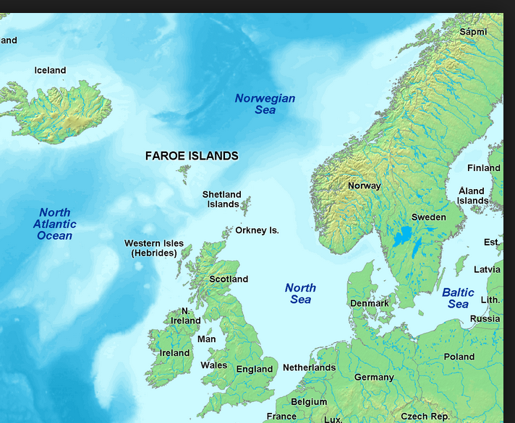
Fareo- Shetland isl’s
Canal transporting
volume of Atlantic waters to
Spitsbergen

