Slide 1
CLISED
Climate Change Impact on Ecosystem Health - Marine Sediment Indicators
(02/2014 - 01/2017)
www.iopan.gda.pl/clised
This project is funded by Norway Grants, the Polish-Norwegian Research Programme operated by the National Centre for Research and Development

Slide 2
Project Promoter and partners
Project promoter
Institute of Oceanology Polish Academy of Sciences, Sopot, Poland
Coordinator: prof. Grażyna Kowalewska (Kowalewska@iopan.gda.pl)
Project partner 1
University of Gdańsk (UG), Gdańsk, Poland
Contact: prof. Hanna Mazur-Marzec (biohm@univ.gda.pl)
Project partner 2
Norwegian Geotechnical Institute (NGI), Oslo, Norway
Contact: prof. Gijs D. Breedveld (Gijs.Breedveld@ngi.no)
Project partner 3
Norwegian University of Science and Technology (NTNU), Trondheim, Norway
Contact: dr. Tomasz Maciej Ciesielski (tomasz.m.ciesielski@ntnu.no)

Slide 3
Aim
Comparison of the Gulf of Gdańsk (Baltic Sea) with Norwegian fjords –
the environmental state & climate change over millennia based on
sediment studies
Current environmental state concerns
such phenomena like:
- primary production
- eutrophication effects
- pollution
- toxic algae blooms.
The climate indicators will characterize
climate-driven environmental phenomena
in the past, like:
high primary production
temperature & salinity changes
oxygen depletion.

Slide 4
Implementation
sediment collection at carefully selected sites
- recent sediments (0–30 cm)
- old sediments (up to 500 cm)
in-situ measurements in water column and the near-bottom water:
dissolved oxygen, temperature, salinity
sub-sampling of the collected sediments
sample storage (-20⁰C, -80⁰C)
analyses of the sediment samples using different modern techniques
(phytoplankton pigments, inorganic indicators, pollution indicators,
geological proxies, biotoxins, toxicity)

Slide 5
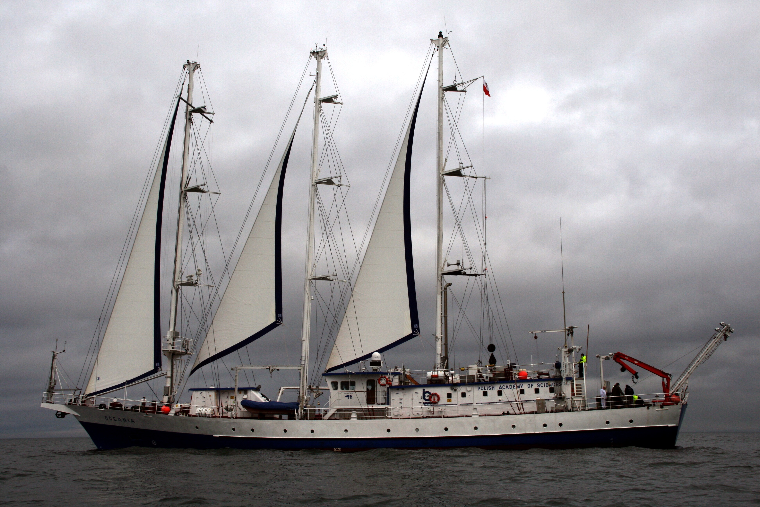
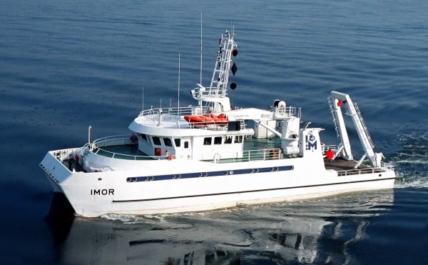
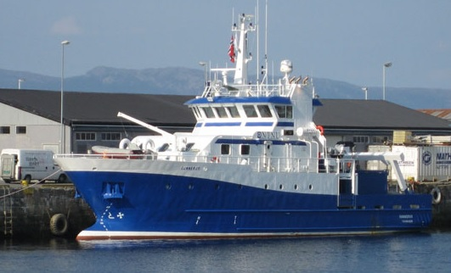
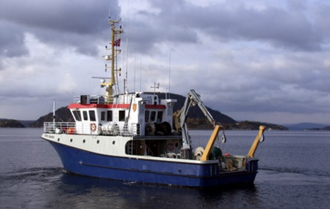
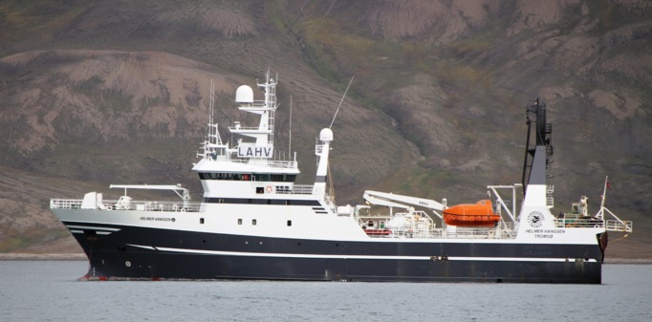
r/v OCEANIA
Cruises
1. Gulf of Gdańsk, 11-17.04.2014
r/v Oceania, IO PAN, Sopot
Oslofjord/Drammensfjord, 7-12.06.2014
r/v Oceania, IO PAN, Sopot
Gulf of Gdańsk, 10.04.2015
r/v IMOR, IM, Gdańsk
Trondheimsfjord, 26.08.2015
r/v Gunnerus, NTNU, Trondheim
Oslofjord, 14.09.2015
f/f Trygve Braarud, OU, Oslo
Balsfjord (Troms), 3.10.2015
f/f Helmer Hanssen, TU, Tromsø
r/v IMOR
r/v GUNNERUS
f/f TRYGVE BRAARUD
f/f HELMER HANSSEN

Slide 6
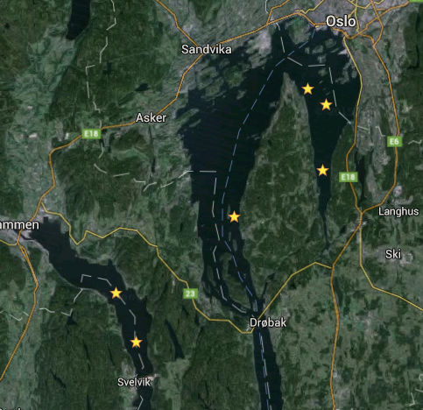
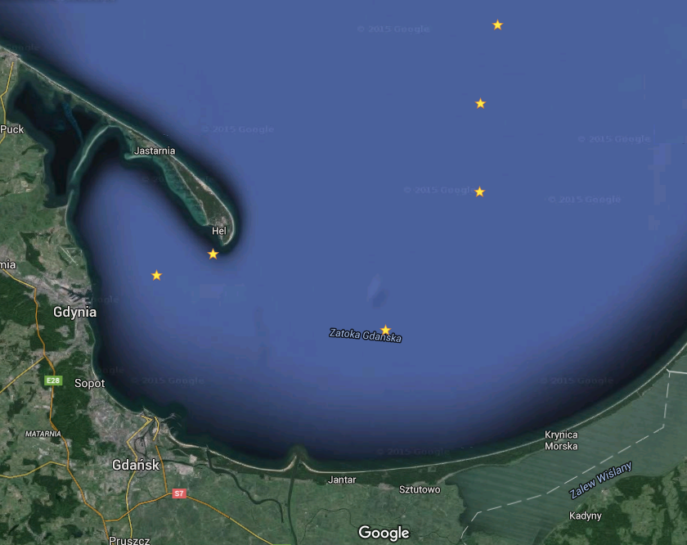
Sampling sites –
recent sediments (0-30 cm)
2. Oslofjord/Drammensfjord
1. Gulf of Gdańsk

Slide 7
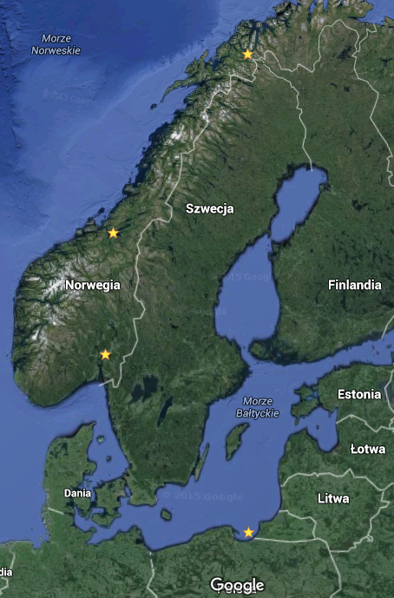
4
Sampling sites –
old sediments (up to 500 cm)
2
Gulf of Gdańsk
Trondheimsfjord
Oslofjord
Balsfjord
3
1

Slide 8
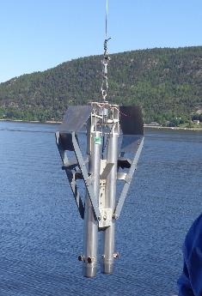
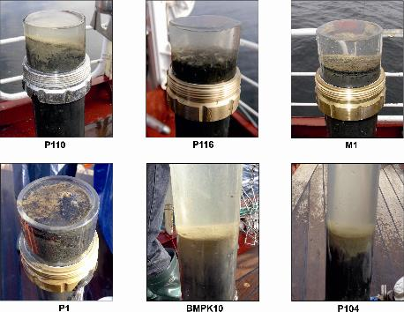
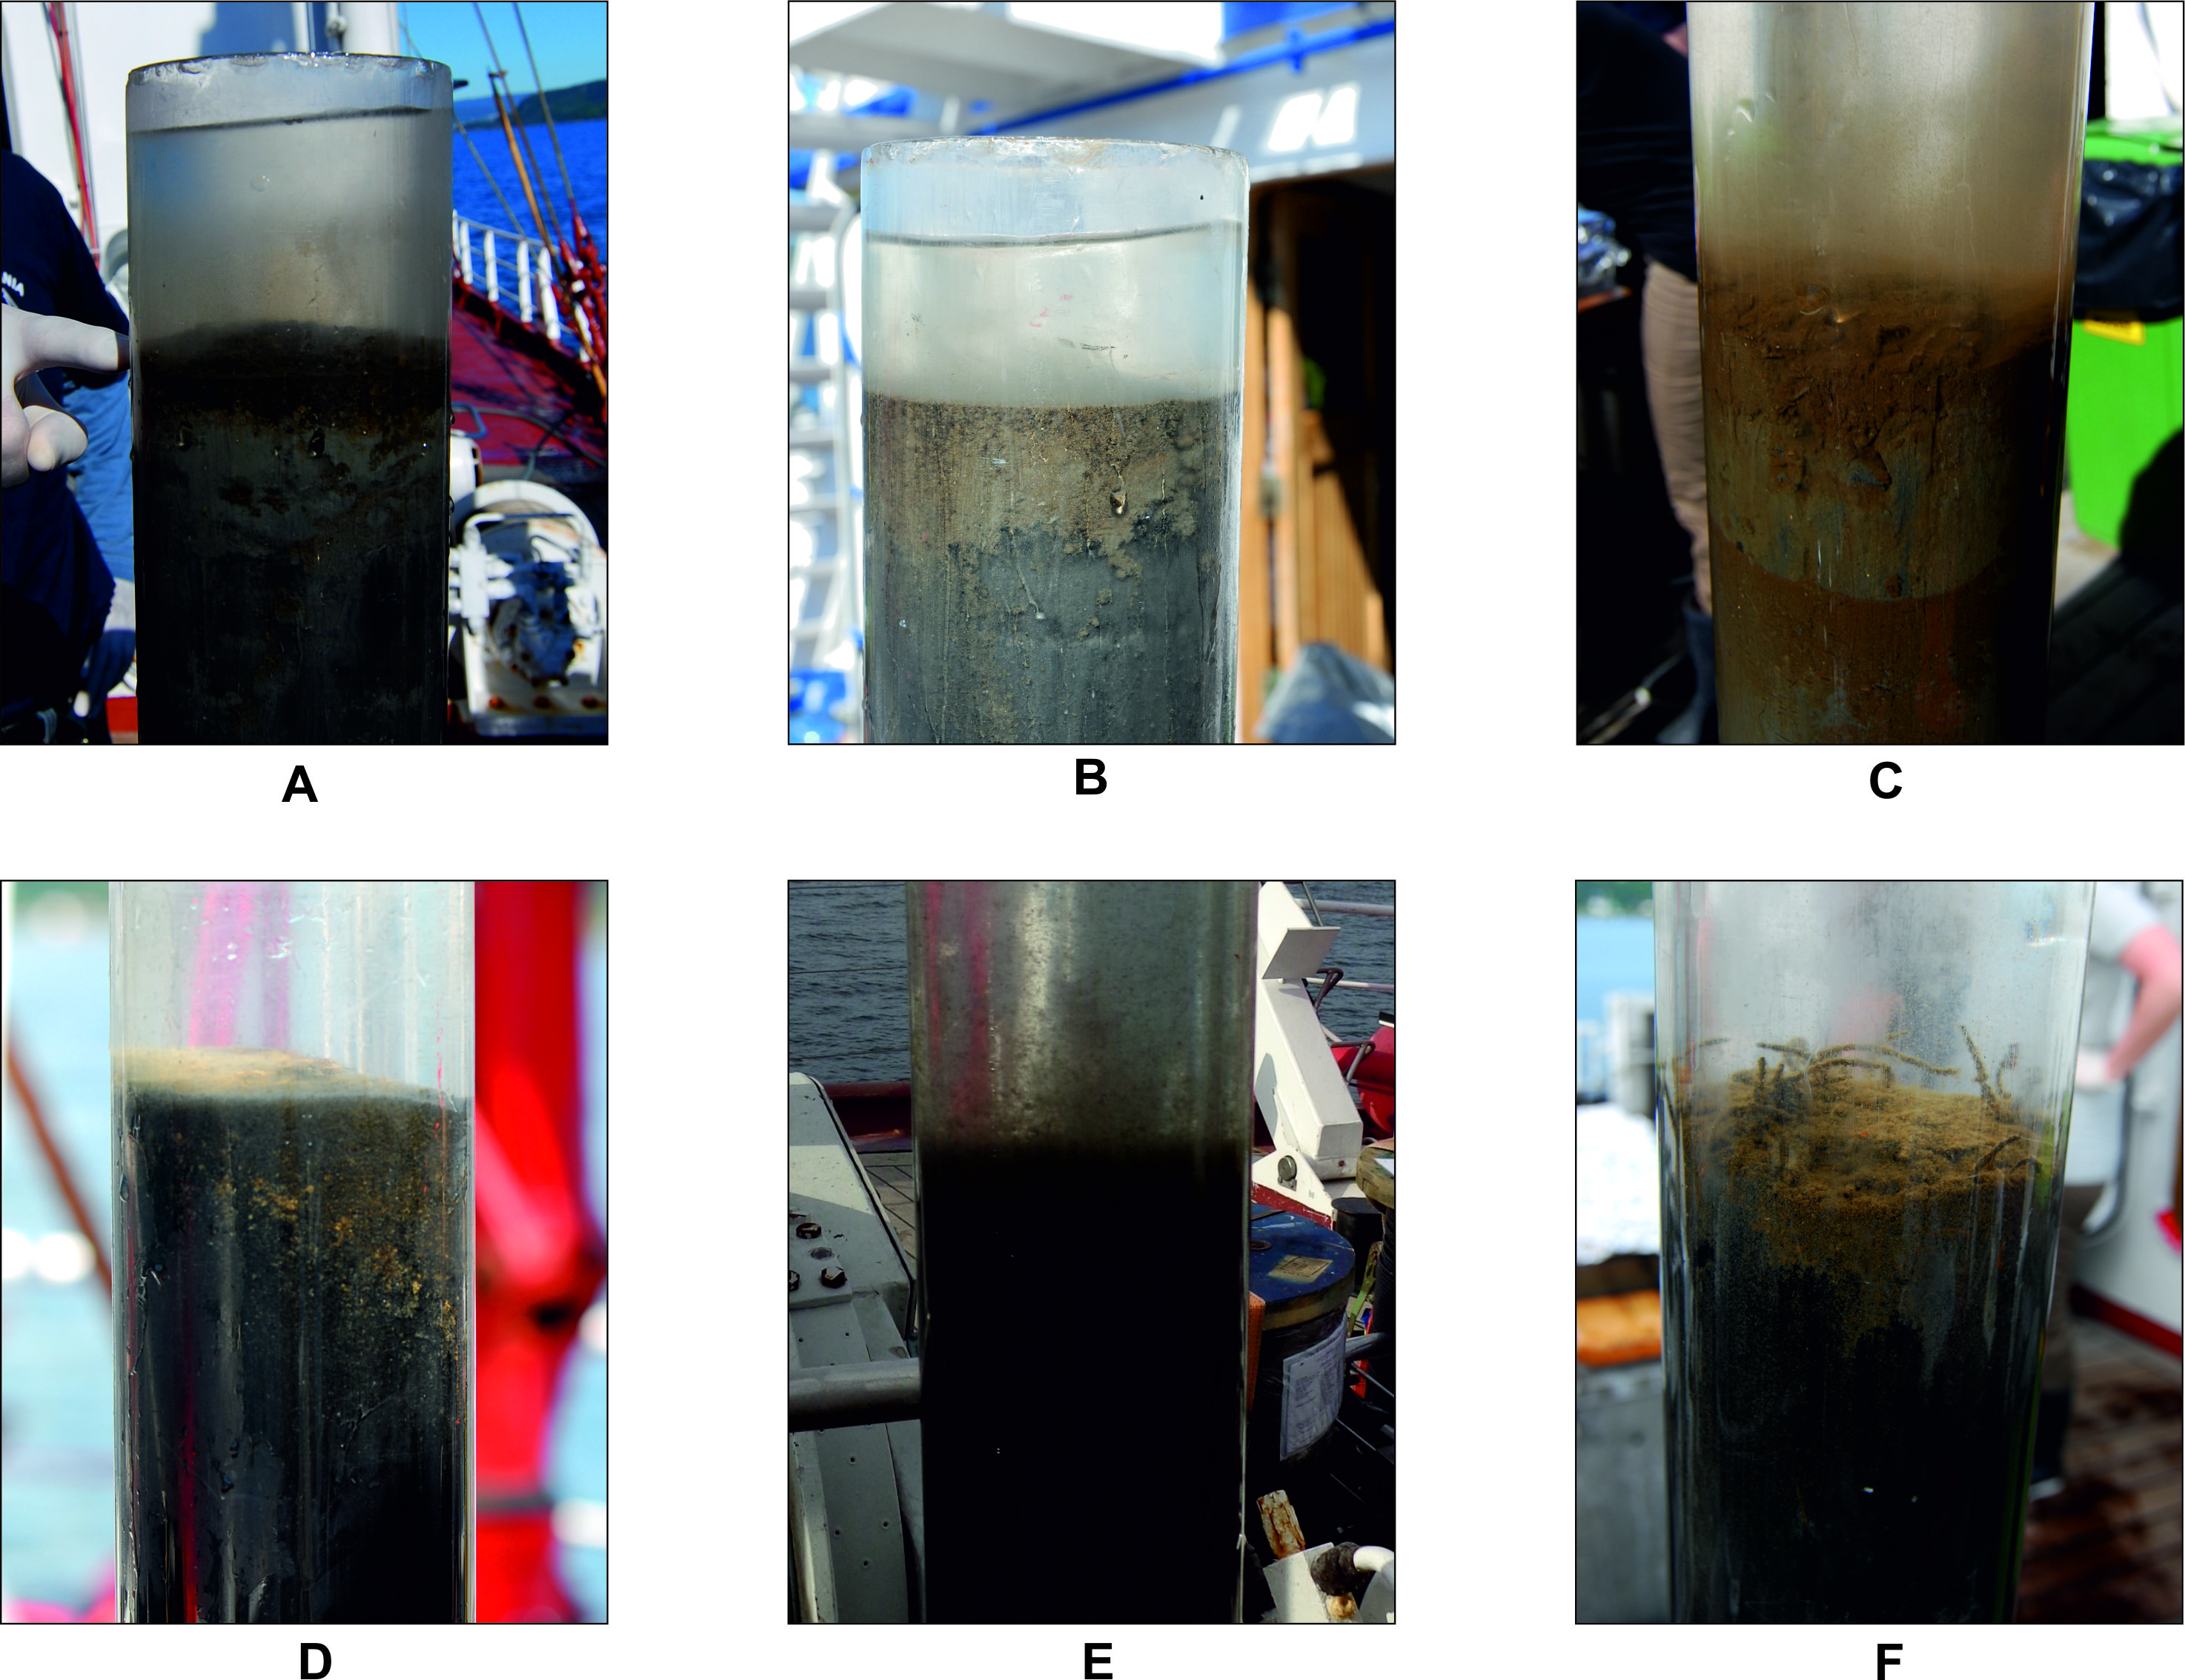
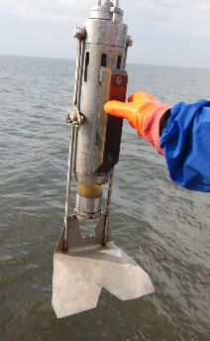
Sediment collection
recent sediments (0-30 cm)
(Niemistö core sampler, GEMAX twin-core sampler)

Slide 9
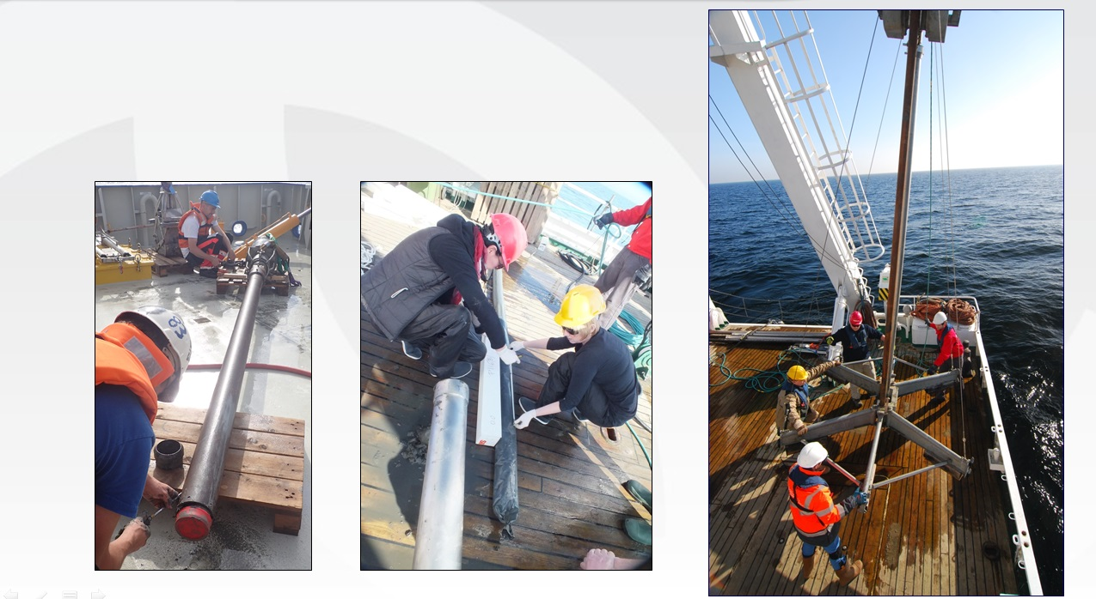
Sediment collection
old sediments (up to 500 cm)
(vibro-corer, gravity corer)

Slide 10
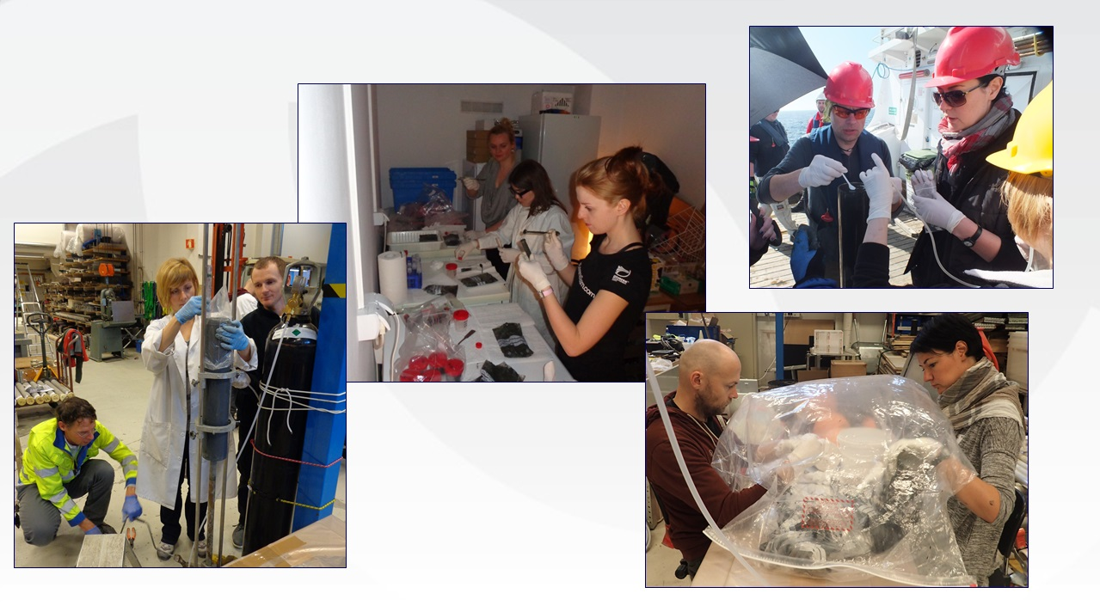
Sediment collection
sub-sampling

Slide 11
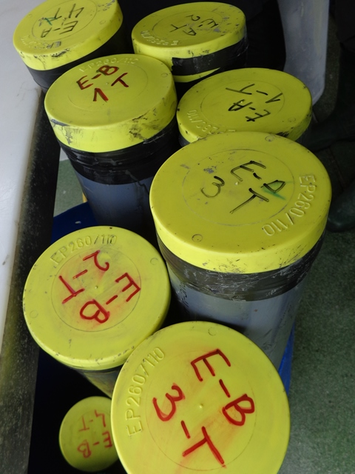
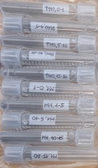
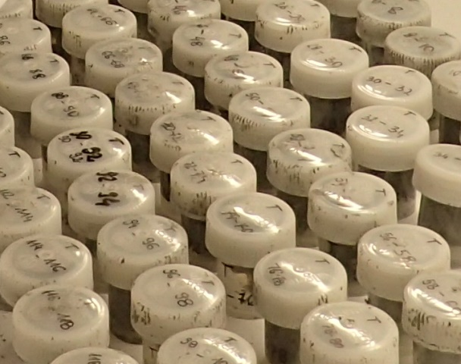
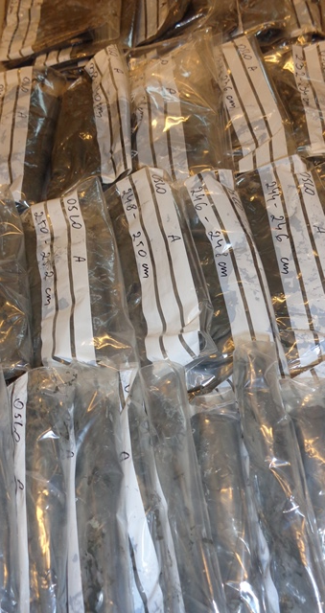
Sampling summary
1st year – 2014: recent sediments (0-30 cm)
12 stations
120 sediment cores
640 sediment layers
672 sub-samples
2nd year – 2015: old sediments (up to 500 cm)
4 stations
9 long sediment cores
1504 sediment layers
4080 sub-samples
Total: ca. 5000 cm of cores, Ø = 10 cm, 4752 sub-samples

Slide 12
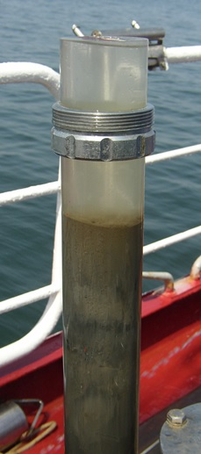
Analyses
grain-size & humidity
Pb-210 dating / C-14 dating
C_{org}, N_{tot}, black carbon, δ¹⁵N/¹⁴N, δ¹³C/¹²C - EA/IRMS
phytoplankton pigments; HPLC-DAD, FL
contaminants (PAHs, OTs, NPs) - GC-MS
Elements (69 & their forms) - HR-ICP-MS
Biotoxins – DNA analyses, LC-MS/MS
Diatoms (geological proxies)
genotoxicity, mutagenicity, endocrine-disrupting activity
- CALUX assays

Slide 13
Results
scientific paper (submitted for publication)
’Pigments in recent sediments as environmental indicators – comparison of the Gulf of Gdańsk (southern Baltic) and the Oslofjord/Drammensfjord (Norway)’,
authors: M.Szymczak-Żyła, M.Lawręc, A.Winogradow,
A.Zaborska, G.D.Breedveld, G.Kowalewska*
scientific conferences
9th International SedNet conference (oral presentation),
Kraków 23-26.09.2015
’Marine sediment indicators in the Gulf of Gdańsk and Oslofjord -
a comparison of climate change impacts on the ecosystem’
authors: G.Kowalewska, H.Mazur-Marzec, G.D.Breedveld, T.Ciesielski, A.Filipkowska, M.Szymczak-Żyła, L.Lubecki, M.Lawręc, A.Oen

Slide 14
- 31st IAS Meeting, 22-25.06.2015 (poster),
Kraków (International Association of Sedimentologists)
’Chloropigment in deep marine sediments as proxies of climate change - driven eutrophication’
authors: M.Szymczak-Żyła, G.Kowalewska, G.D.Breedveld
- ECSA 55 Conference, 6-9.09.2015 (poster),
London (Estuarine Coastal Sciences Association)
’Chloropigments proxies in recent sediments – comparison of the Gulf of Gdańsk (Poland) and Drammen/Oslofjord (Norway)’
authors: M.Szymczak-Żyła, G.Kowalewska, A.Filipkowska, L.Lubecki, M.Lawręc, A.Zaborska, A.Winogradow

Slide 15
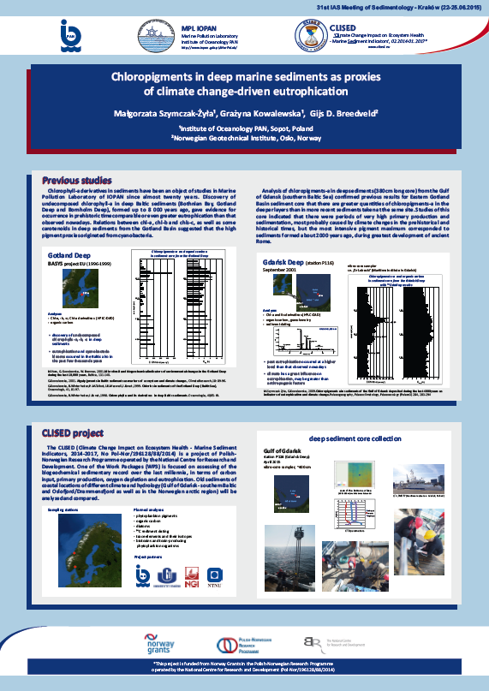
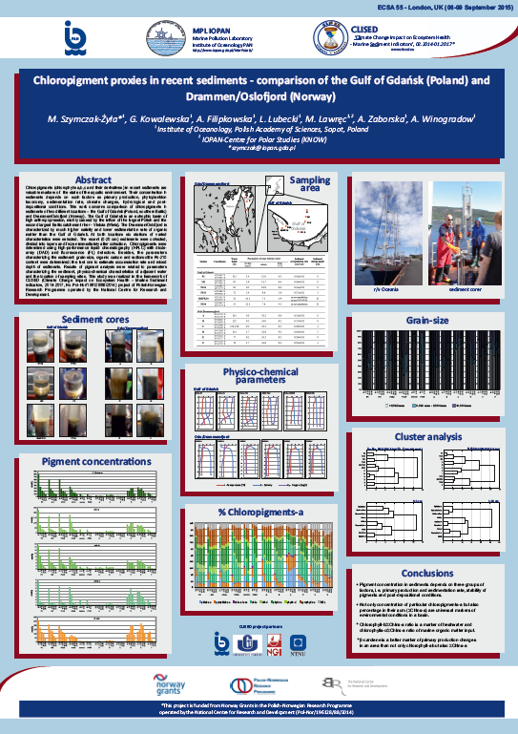
31 IAS, Kraków 2015, 23-26.09
55 ECSA, London 2015, 6-9.09

Slide 16
Project promotion
leaflets
XI Conference of Marine Chemistry Section of the Polish Scientific
Committee on Ocean Research, IO PAN, Sopot, 24.10.2014 (poster)
’Indicators of environmental state – recent sediments of the Gulf of Gdańsk and the Oslo’
authors: G.Kowalewska, M.Szymczak-Żyła, A.Filipkowska, L.Lubecki, I.Złoch, A.Zaborska, A.Winogradow, H.Mazur-Marzec, A.Toruńska- Sitarz, A.Krakowiak, T.Ciesielski, M.Ardelan, G.D.Breedveld, A.Oen
- VIII Sopot Day of Science, Sopot, 23.05.2015 (poster)
'Climate Change Impact on Ecosystem Health - Marine Sediment Indicators', 02.2014-01.2017

Slide 17
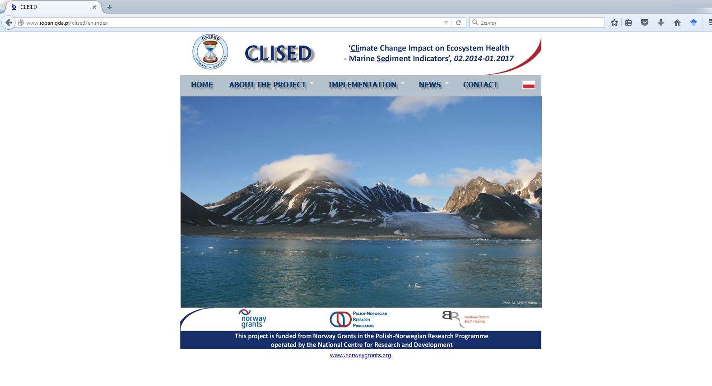
webpage (http://www.iopan.gda.pl/clised/)
Webpage

